Slide 1

CSE0471 APPLIED dEEP LEARNING <PROJECT: MUSIC GENERATION uSING Bılstms>
Emrehan Gökçay
Bora Mehmet sukuşu
Görkem köse

Slide 2
Content
Introduction
What are RNN’s?
What are LSTM’s and why we specifically chose them?
What ‘’Bidirectionality’’ means in RNN’s?
Used key structures/libraries/datasets.
Explaining our model.
The aftermath after we used Bidirectional LSTM’s compared to normal LSTM’s.
Output music.
References

Slide 3

Introduction
We focus on generating music using Recurrent Neural Network architectures.
Our target is to develop a model for composing music by learning from datasets consisting of MIDI files.

Slide 4
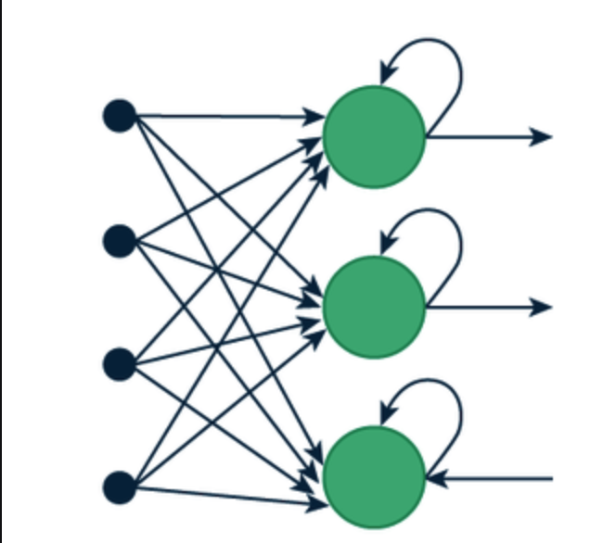
What are RNN’s?
RNNs are neural networks designed for sequence data.
They have loops that allow information to maintain.
Ideal for tasks with dependencies like language, speech, and music.

Slide 5

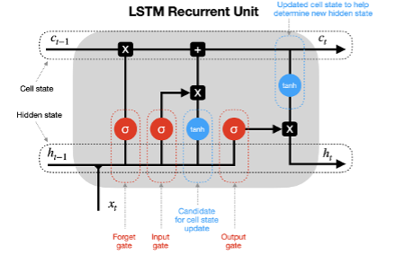
What are LSTM’s and why we specifically chose them?
LSTM’s are a type of RNN that can learn long-term dependencies.
They solve the vanishing gradient problem(explain VGP here) with gate structures.
Ideal for their ability to handle long sequences, crucial for music.

Slide 6
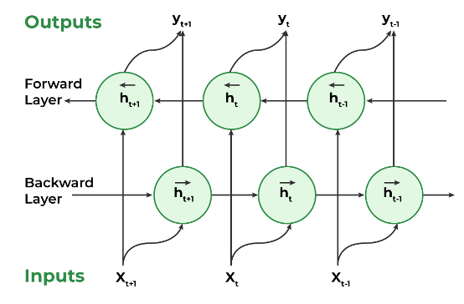
What ‘’Bidirectionality’’ means in RNN’s?
Bidirectional RNN’s process sequences in both forward layer and bakcward layers.
Captures information from both past and future at each point.
In music, this means more accurate note predictions by taking notes from future notes.
That is why we’re using Bidirectional LSTM based architecture in our model.

Slide 7

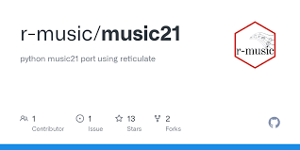


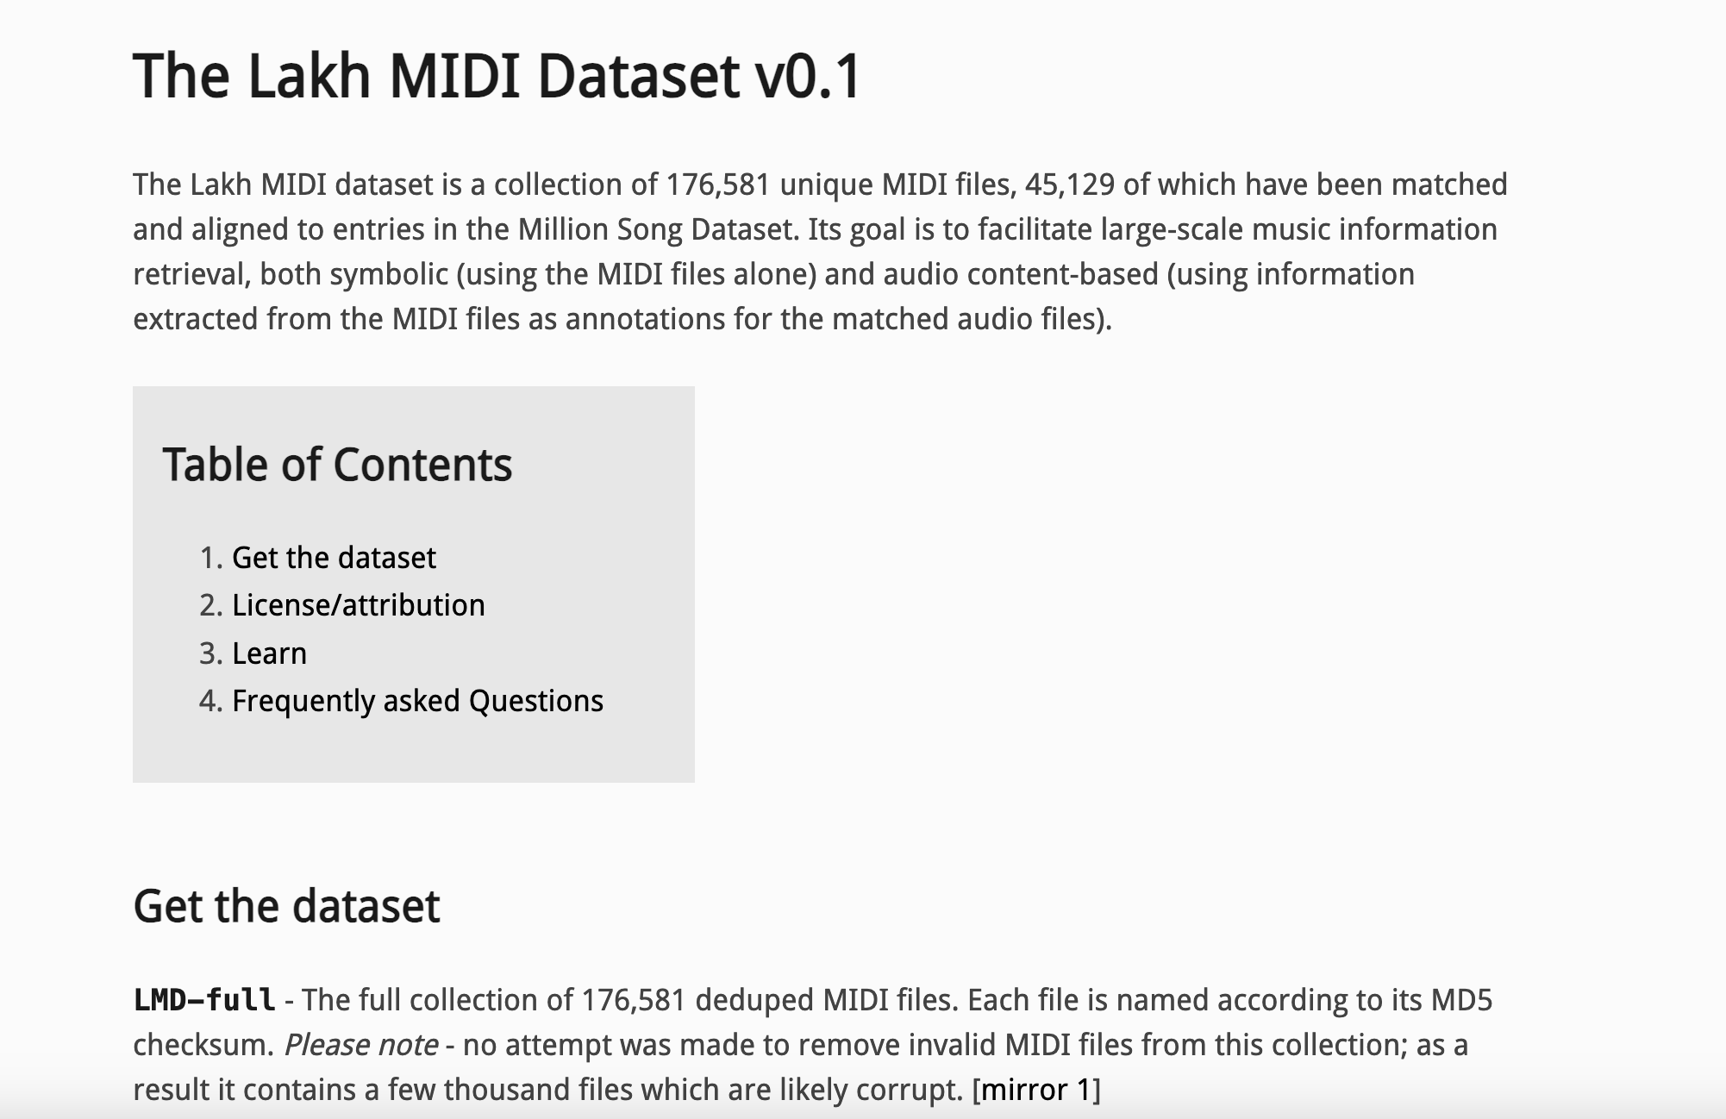
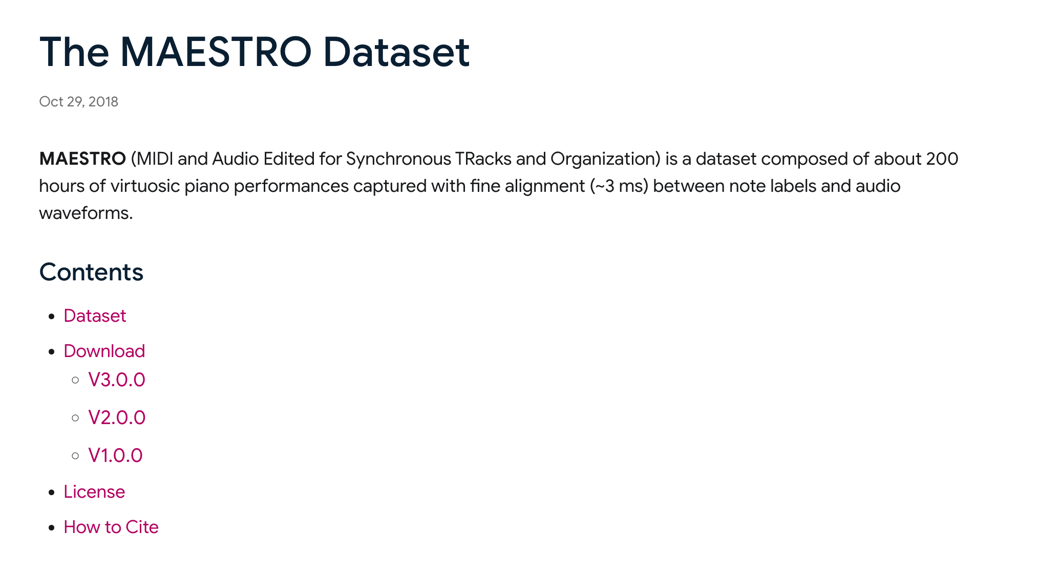
KEY STRUCTURES/LIBRARIES USED
DATASETS USED
Lakh MIDI Dataset
MAESTRO V2.0.0 Dataset

Slide 8
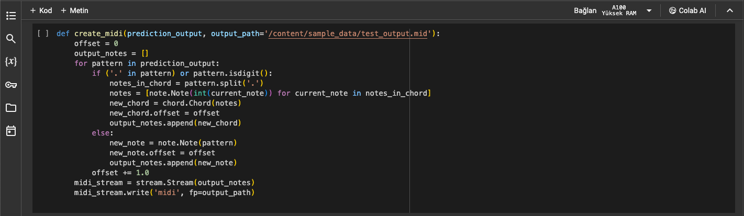
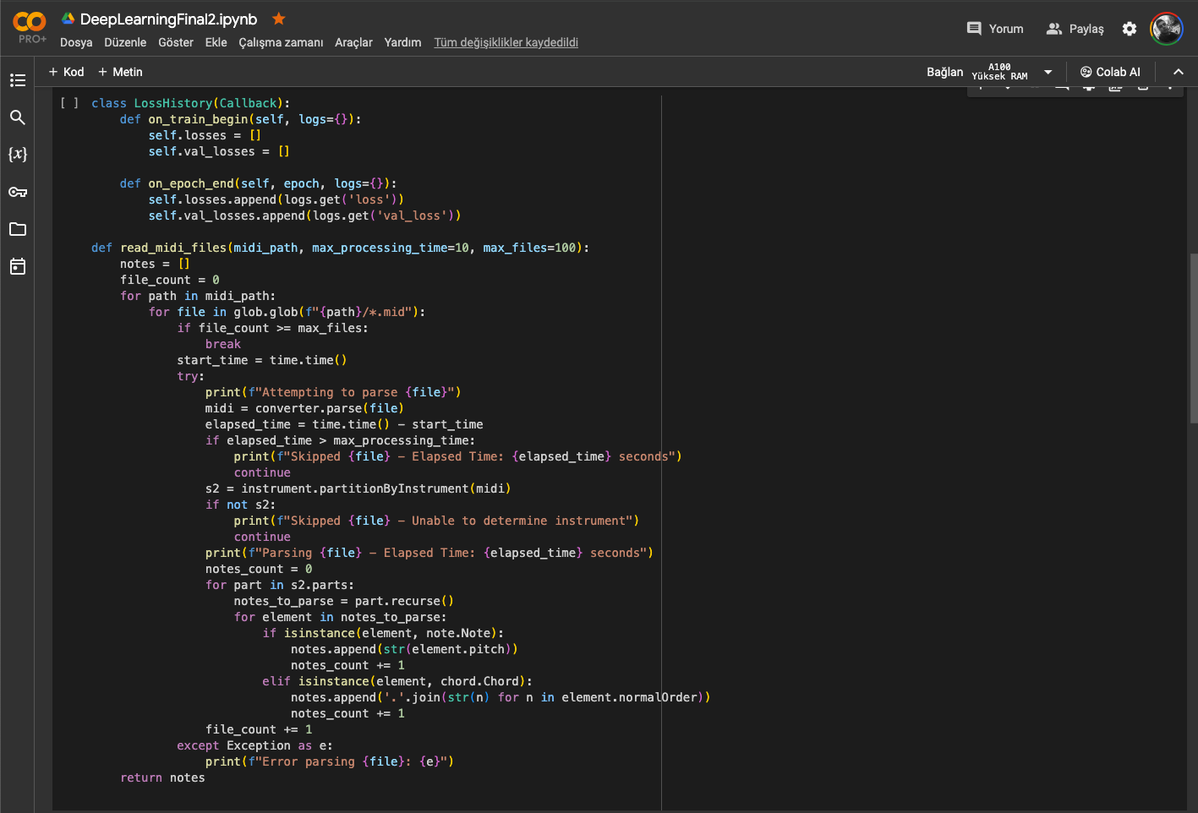
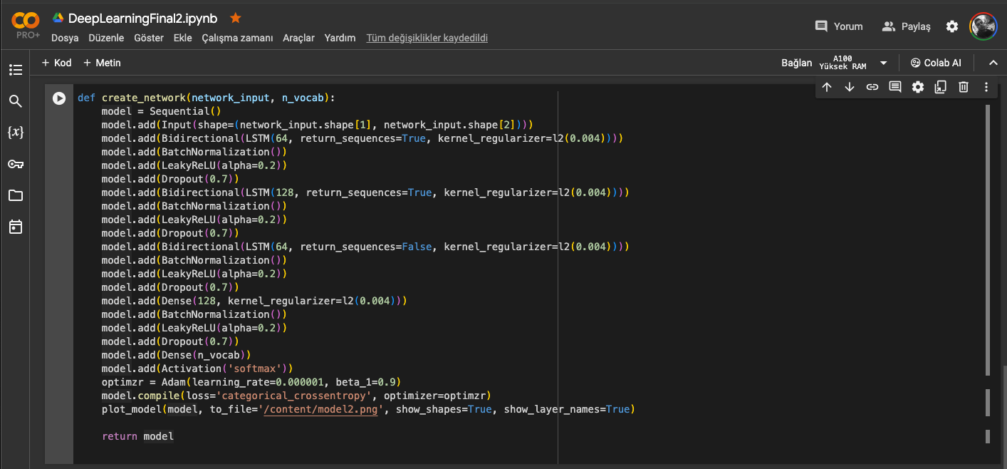
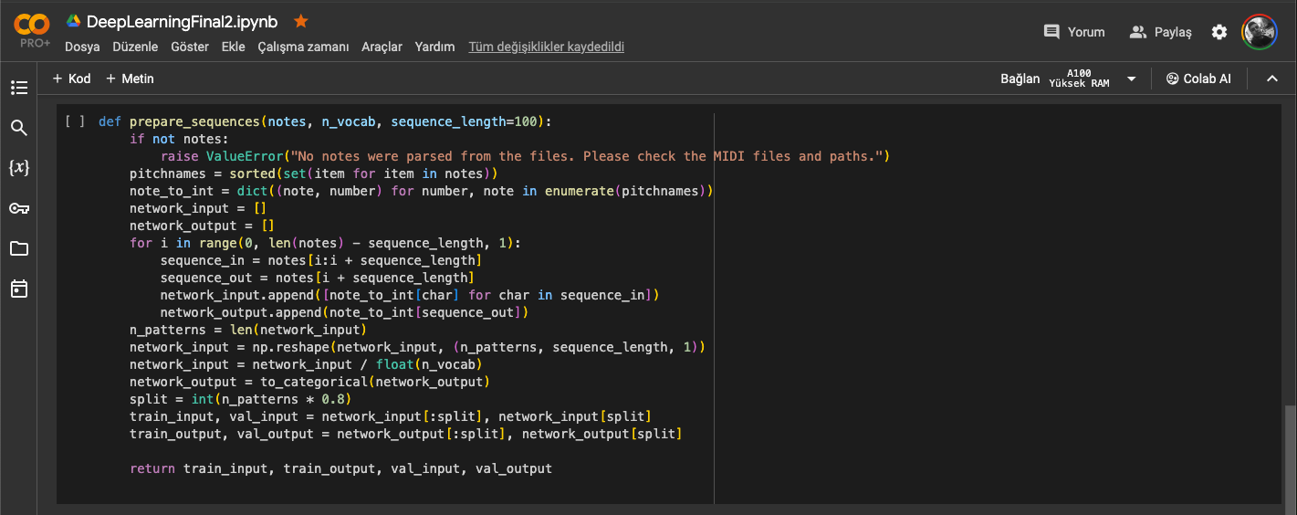
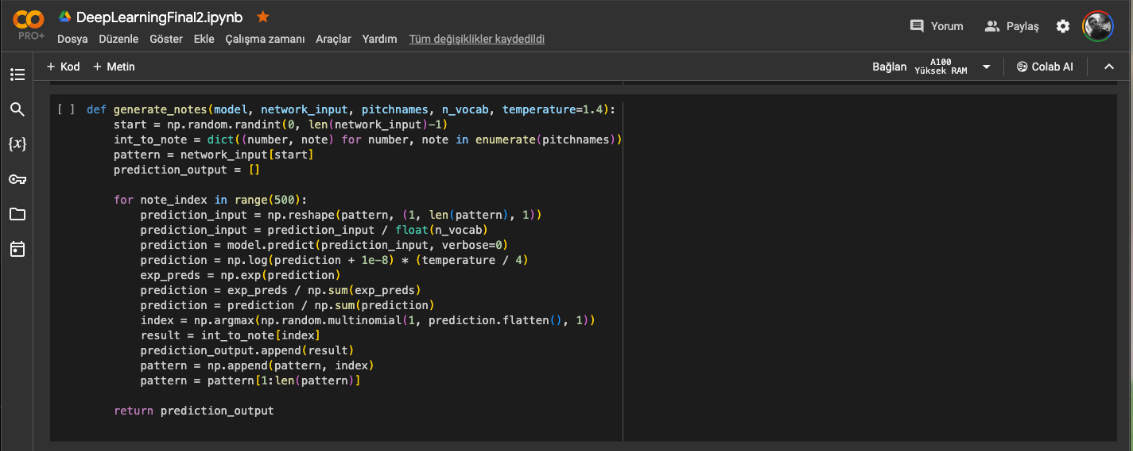
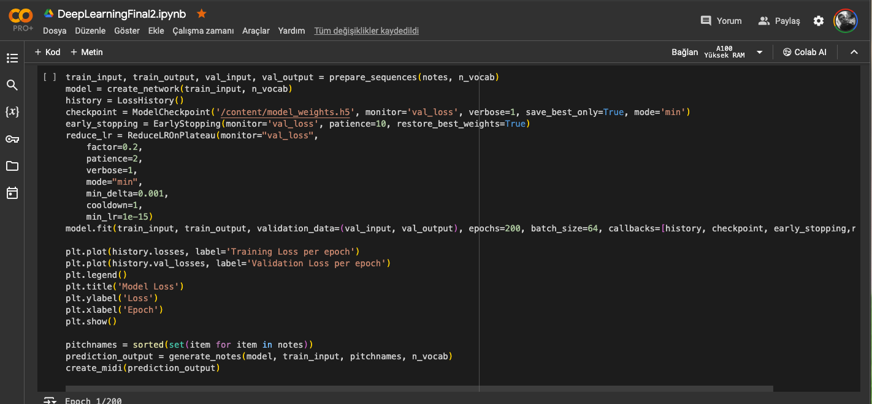
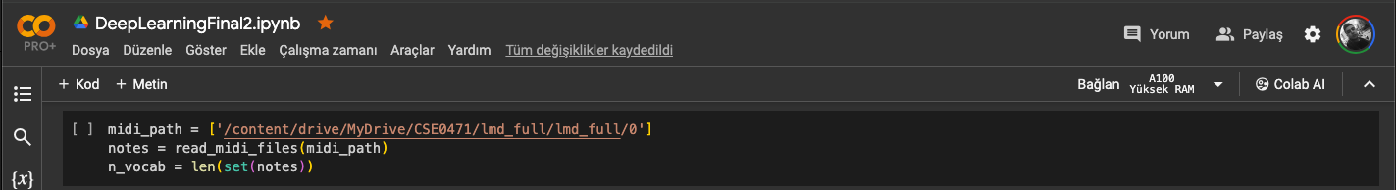
Explaining the model

Slide 9
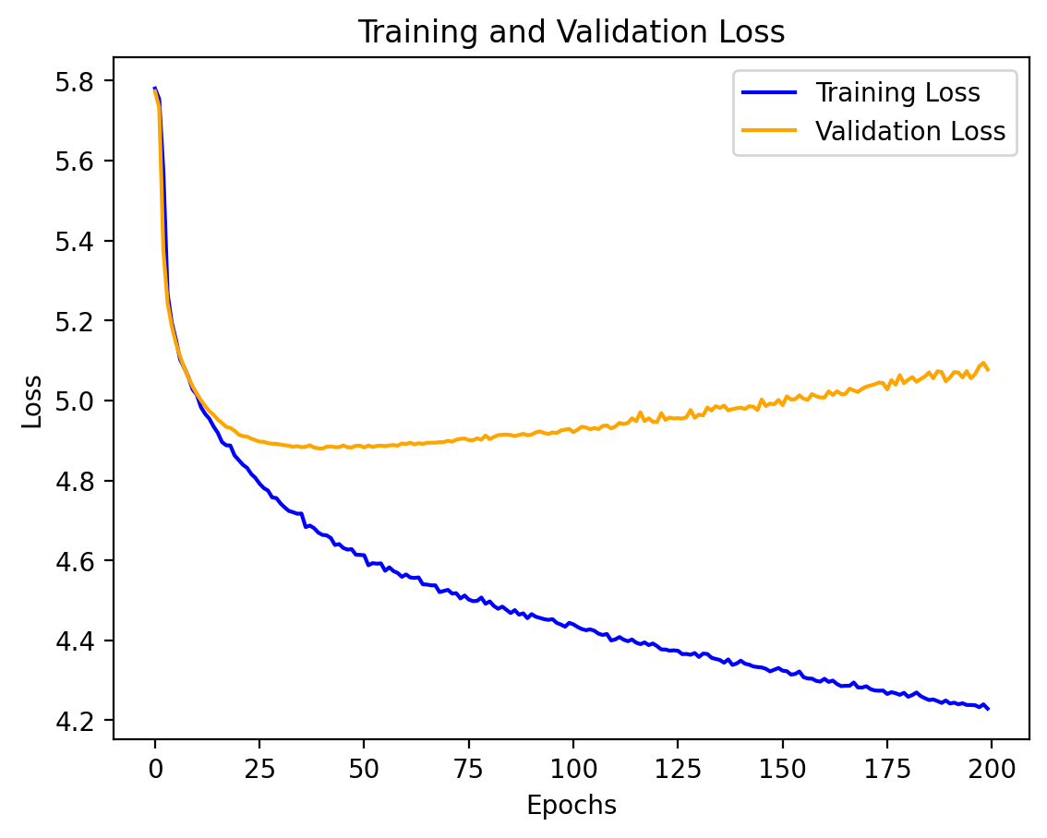
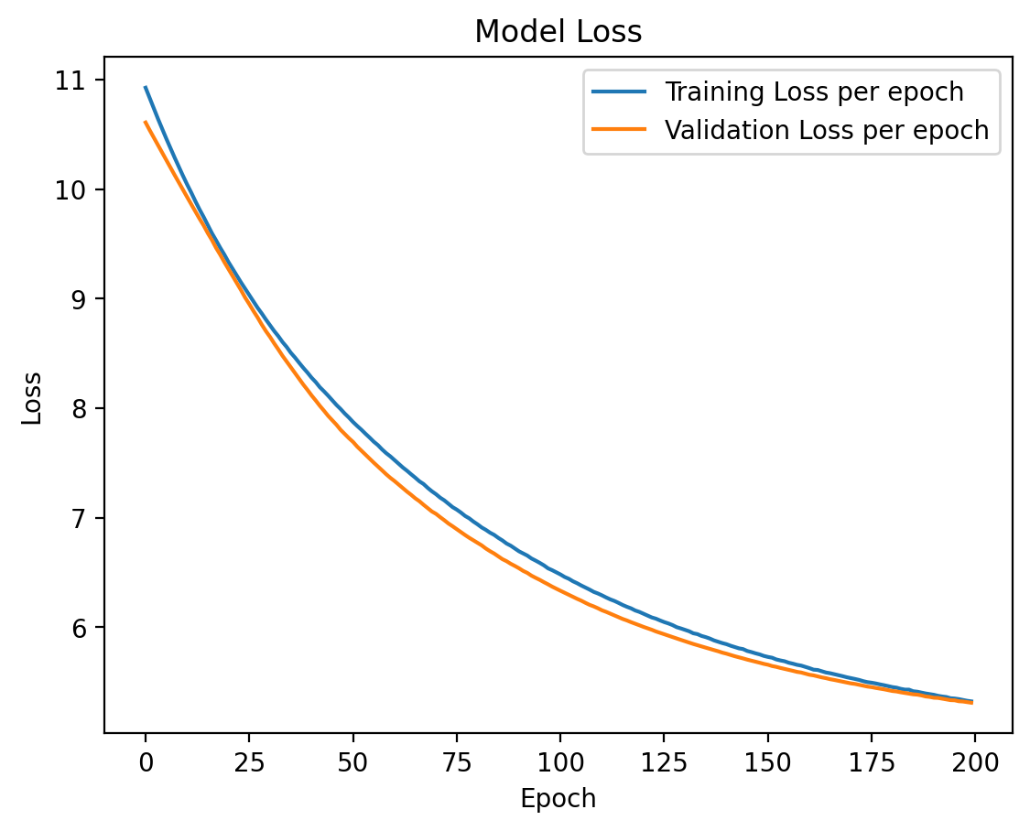
The aftermath after we used Bidirectional LSTM’s compared to normal LSTM’s

Slide 10
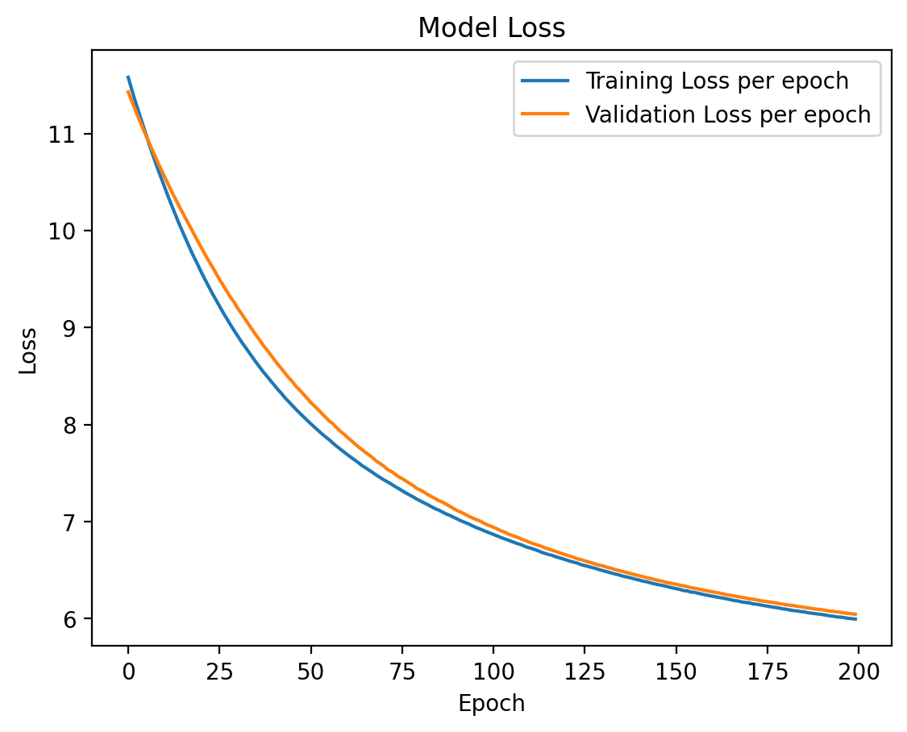
Comparison of our model between different datasets in terms of performance
This is the graph of network’s model loss(training loss) after using to train Lakh Midi Dataset, taking 100 music samples with 200 epochs of training and training batch size of 64.
This is the graph of network’s model loss(training loss) after using to train MAESTRO dataset, taking 100 music samples with 200 epochs of training and training batch size of 64.

Slide 11

Output Music:
This is our final music created by training LMD dataset.
This is our final music created by training MAESTRO dataset.
This was our music using standard LSTM architecture created by training LMD dataset.

Slide 12
References
https://colinraffel.com/projects/lmd/
https://www.magenta.tensorflow.org/datasets/groove
https://medium.com/@souro400.nath/why-is-bilstm-better-than-lstm-a7eb0090c1e4
A. Ranjan, V.N. J. Behera, M. Reza, “Using a Bi-directional LSTM Model with Attention Mechanism trained on MIDI Data for Generating Unique Music”, Available on : https://arxiv.org/pdf/2011.00773
T. Jiang, X. Yin, Q. Xiao, “Music Generation Using Bidirectional Recurrent Network”, Available on: https://ieeexplore.ieee.org/document/8839399
https://app.cyanite.ai
https://www.geeksforgeeks.org/data-science-with-python-tutorial/
https://cifkao.github.io/html-midi-player/
https://www.geeksforgeeks.org/bidirectional-recurrent-neural-network/
https://medium.com/@sreeku.ralla/activation-functions-relu-vs-leaky-relu-b8272dc0b1be
https://www.analyticsvidhya.com/blog/2021/03/introduction-to-long-short-term-memory-lstm/
https://web.mit.edu/music21/doc/index.html
https://keras.io/api/
https://towardsdatascience.com/how-to-generate-music-using-a-lstm-neural-network-in-keras-68786834d4c5

Slide 13
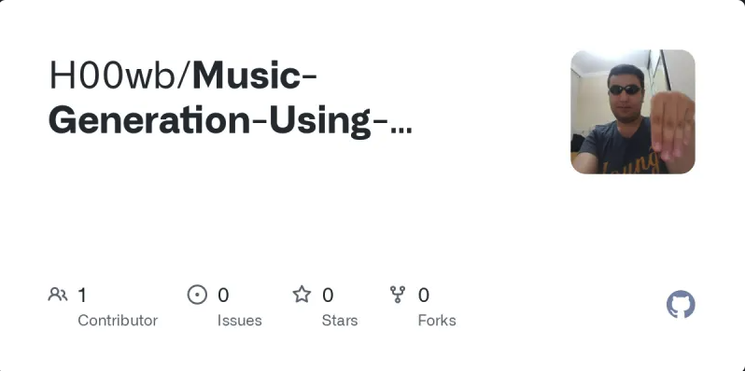
Project is currently listed on my Github page
https://github.com/H00wb/Music-Generation-Using-BiLSTM

Slide 14


